Slide 1
TOMATO LEAF DISEASE PREDICTION USING CNN
A Convolutional Neural Network based image classification model to disease in tomato plant leaves

Slide 2
Problem Definition
Tomato is one of the most essential and consumable crops in the world. Tomatoes differ in quantity depending on how they are fertilized. Leaf disease is the primary factor impacting the amount and quality of crop yield. As a result, it is critical to diagnose and classify these disorders appropriately. Different kinds of diseases influence the production of tomatoes. Earlier identification of these diseases would reduce the disease’s effect on tomato plants and enhance good crop yield. Different innovative ways of identifying and classifying certain diseases have been used extensively. The motive of work is to support farmers in identifying early-stage diseases accurately and informing them about these diseases. The Convolutional Neural Network (CNN) is used to effectively define and classify tomato diseases.

Slide 3
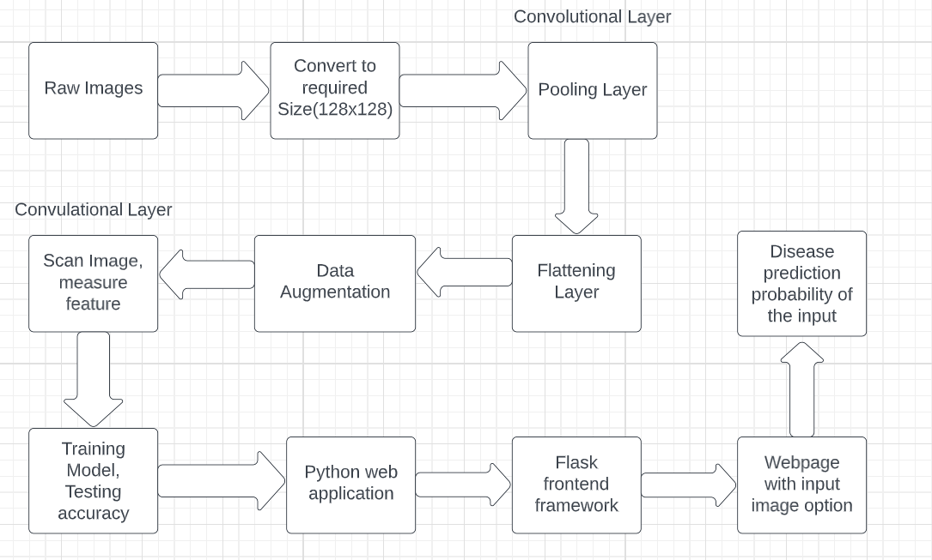
System Design Description

Slide 4
MODULE DESCRIPTION
Data Acquisition - Data Acquisition is composed of two words: Data and Acquisition, where data is the raw facts and figures, which could be structured and unstructured and acquisition means acquiring data for the given task at hand.
Data Partition - Partitioning a data set is splitting the data into two, sometimes three smaller data sets. These are called Training, Validation and Test. This technique is best practice when creating a predictive model but is only possible when working with enough data. Test data sets are less common due the volume of data required.
Data Augmentation - Data augmentation is a technique of artificially increasing the training set by creating modified copies of a dataset using existing data. It includes making minor changes to the dataset or using deep learning to generate new data points
Model Creation - Modelling in machine learning is an iterative phase where a data scientist continually trains and test machine learning models to discover the best one for the given task.

Slide 5
Testing - Testing helps spot problems in models that regular evaluation metrics might miss. These problems can come from the code that enables each element of the ML system to function or from the data where outliers and an uneven distribution split, among other things, can affect the model's performance.
Training and Validation - Training a machine learning model is a process in which a machine learning algorithm is fed with training data from which it can learn to split data, select algorithm, tune the hyperparameter values, train a model and select another algorithm.
Convolutional Neural Network - A convolutional neural network (CNN or ConvNet) is a network architecture for deep learning that learns directly from data. CNNs are particularly useful for finding patterns in images to recognize objects, classes, and categories. They can also be quite effective for classifying audio, time-series, and signal data.
AlexNet Structure - AlexNet architecture consists of 5 convolutional layers, 3 max-pooling layers, 2 normalization layers, 2 fully connected layers, and 1 softmax layer. Each convolutional layer consists of convolutional filters and a nonlinear activation function ReLU. Input size is fixed due to the presence of fully connected layers.

Slide 6
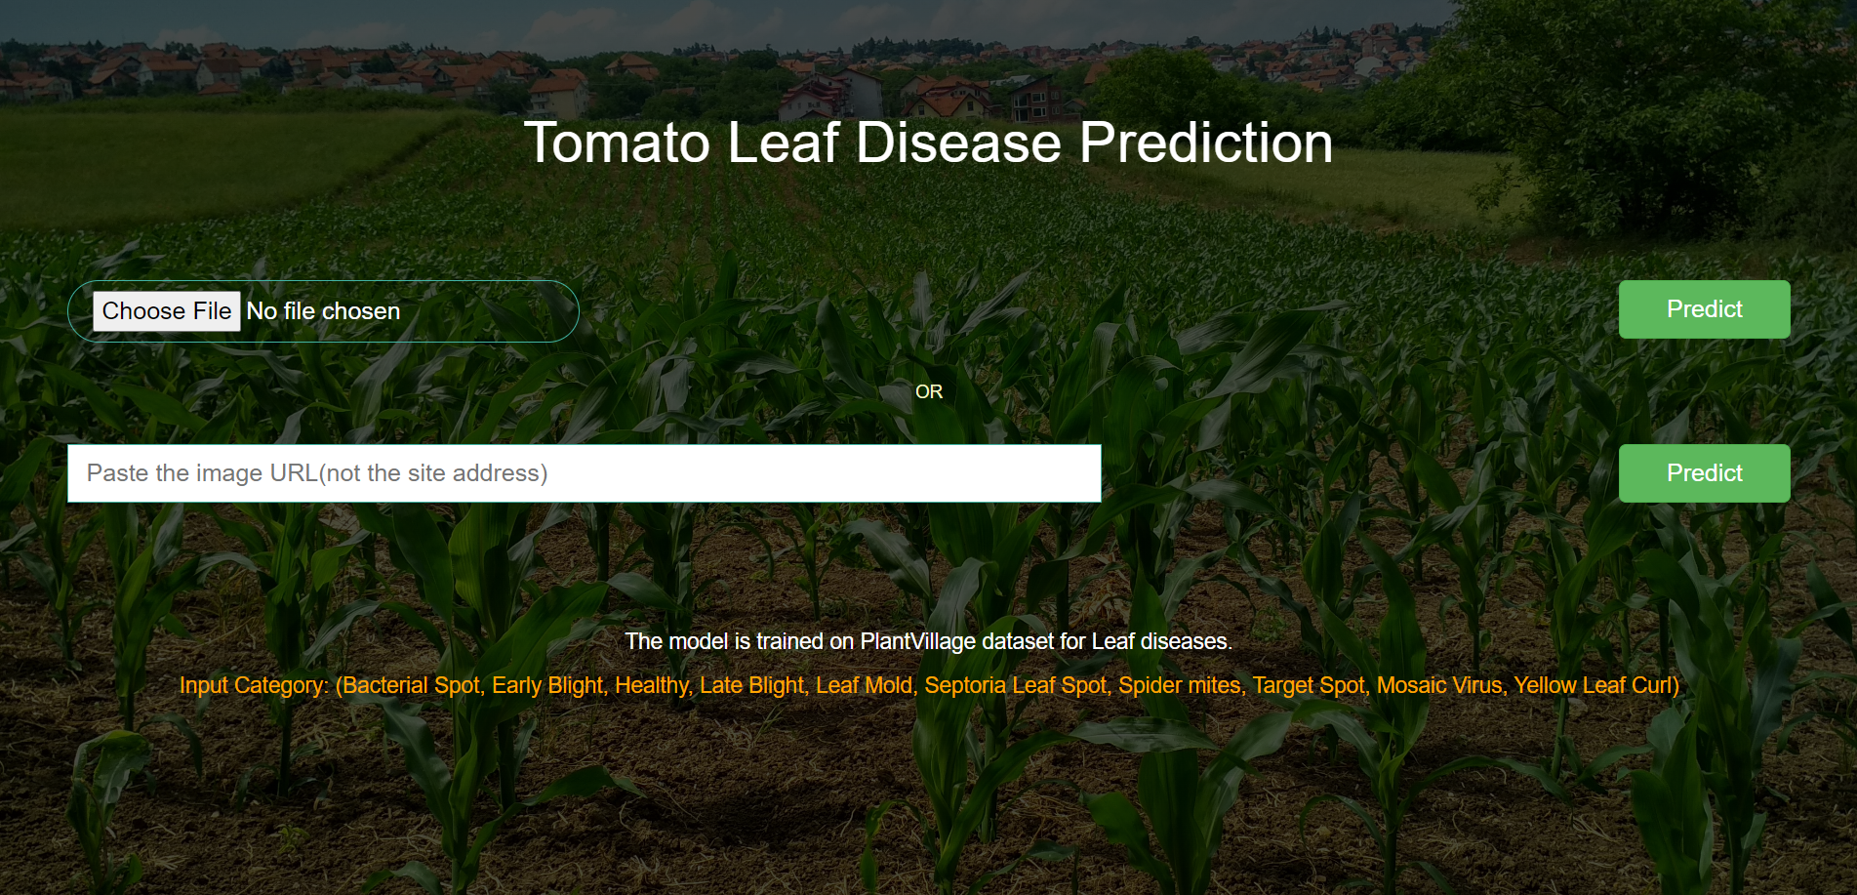
Output

Slide 7
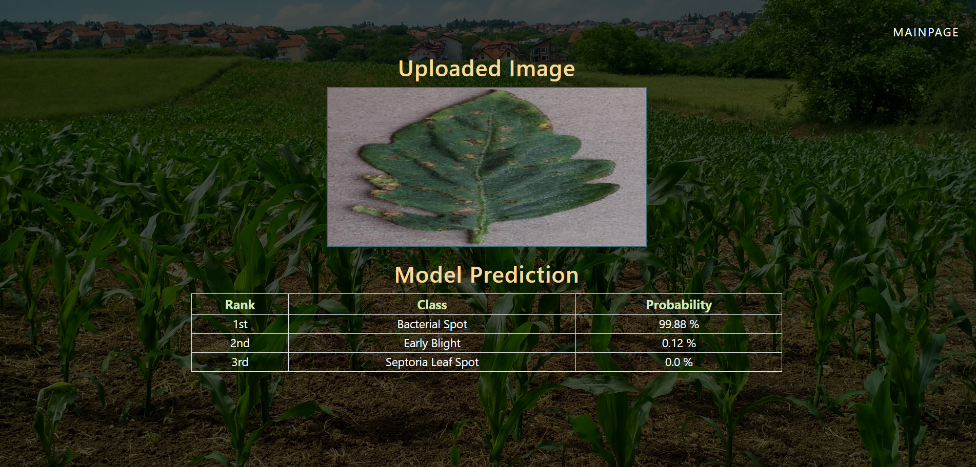

Slide 8
Conclusions
Tomato is one of the most essential and consumable crops in the world. Tomatoes differ in quantity depending on how they are fertilized. Leaf disease is the primary factor impacting the amount and quality of crop yield
We studied dataset using different Machine learning and CNN techniques such as “Support Vector Machine” and “Alex Net Architecture” which gave us the accuracy of 74% and 87%
From the above perspective Alex Net gave the most reliable accuracy for our dataset, which led us to study about Tomato Leaf Diseases with Alex Net to predict diseases for particular leaf input images.

